Slide 1
Paper2Agent for AI4Research
Is it worth a closer look, as a capsule builder in front of admission, the library and the planner?
Decision briefing, under 15 minutes
Notes:
TIME 0:15
SAY: Main points:
- One question: should we look into Paper2Agent further, yes or no
- Answer first, then the evidence

Slide 2
VERDICT
Yes to a short spike, no as the self-improvement loop
Question | Answer | Why
Valuable to AI4Research? | Yes | Turns papers with code into tested, source-backed tools we can admit as capsules
Does it deliver the 16 Oct request? | No | Covers 1 step fully and 1 partly of the 6-step loop. Value judgment, design and before and after tests are ours
Can it be a capability capsule? | Its outputs, yes | The builder stays an offline job: nothing that decides is a capsule
Does it fit admission, library, planner? | Yes, one adapter | Candidate capsule enters the existing M1 path. Planner sees only admitted versions
What does finding out cost? | 3 to 5 days | One repo, one host. Narrow full path is 20 to 35 days (provisional)
paper2agent-reference/00-core-value-and-original-requirement.md; paper2agent-reference/06-paper2agent-cc-container-proposal.md (Paper2Agent commit 8c2d059, static inspection only)
2
Notes:
TIME 1:15
SAY: Main points:
- Recommendation: spend a 3 to 5 day spike, do not adopt it as the whole feature
- Its value is the paper-to-tested-tool conversion, which is real effort saved
- The requested loop is judging value, designing, building, and proving improvement
- Everything else on the slide follows from that split
Supplemental points:
- Final verdict is the team's, this is the recommendation

Slide 3
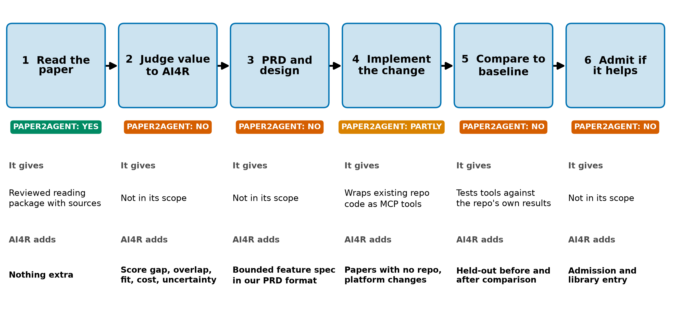
THE ORIGINAL ASK
It covers one loop step fully and one partly
The ask: a paper goes in, AI4R judges it, designs the feature, builds it and gets stronger
paper2agent-reference/00-core-value-and-original-requirement.md: Stellven's request of 16 Oct 2026 as supplied; Paper2Agent skills at commit 8c2d059
3
Notes:
TIME 1:15
SAY: Main points:
- Paper2Agent reads a paper into a reviewed package and wraps existing repo code as tested tools
- It does not judge value to AI4R, write our PRD, or compare to our baseline
- A paper with no usable repo needs another implementation path
Supplemental points:
- The paper-to-skill route gives a reading package, not an executable capability

Slide 4
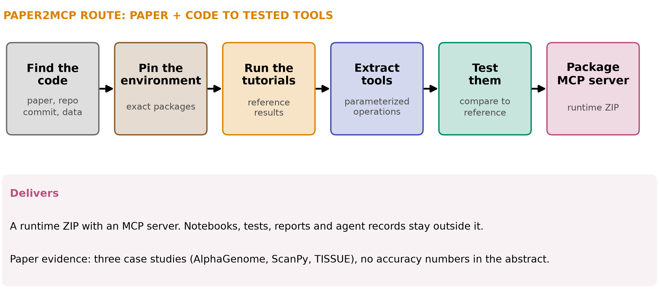
WHAT IT IS
It turns a paper and its repo into tested MCP tools
arXiv 2509.06917 (Paper2Agent, v2 Oct 2025); repo skills: paper2mcp/SKILL.md and references/output-delivery.md
4
Notes:
TIME 1:00
SAY: Main points:
- Multiple agents analyze the paper and codebase, build an MCP server, then generate and run tests to harden it
- Orchestration is instructions for a host agent system, not a ready scheduler we can embed
- The paper reports case studies but no accuracy numbers in the abstract
Supplemental points:
- Runtime ZIP is delivered, evidence is kept outside it, so we must capture both

Slide 5
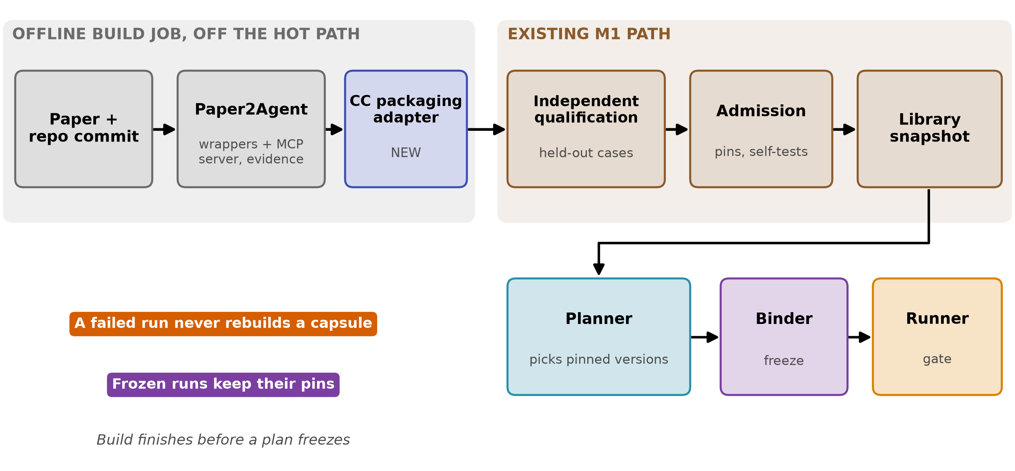
INTEGRATION
Plug it in as an offline builder in front of admission
paper2agent-reference/06-paper2agent-cc-container-proposal.md, lifecycle; design-package/reference/run-plan.md; capability-capsules/library-and-checking.md
5
Notes:
TIME 1:00
SAY: Main points:
- Builder output becomes a candidate capsule through one new packaging adapter
- Independent qualification and protected admission stay exactly as designed for M1
- The planner only sees admitted versions in the library snapshot
- A failed run never rebuilds a capsule, frozen plans keep their pins
Supplemental points:
- Hidden evaluation cases stay outside the builder and the runtime image

Slide 6
MAPPING
Built tools map onto the declaration, with four gaps
Declaration part | Paper2Agent gives | What we must add
ports | MCP tool input and output schemas | Scientific units and applicability, JSON shape is not enough
needs, changes | Dataset and model pins, output files | Runtime needs from build deps. Block path parameters and hidden effects
guarantees | Tests against upstream reference results | Independent held-out cases the builder cannot see
lineage | Build history and evidence | A linked source and build manifest, lineage object is closed
one tool per capsule | A server with many tools | Per-tool access limit so one grant is not every tool
paper2agent-reference/06-paper2agent-cc-container-proposal.md, section: how the existing M1 CC can represent the result
6
Notes:
TIME 1:00
SAY: Main points:
- The declaration categories already fit, so the schema does not change for a pilot
- The work is the importer, the manifest, and independent evidence
- Composite execution is deferred, so dependent operations become separate planned nodes
Supplemental points:
- Keep runtime ZIP and evidence bundle together or qualification loses its basis

Slide 7
DECISION
Offline builder yes, library capsule no
Option | Verdict | Reason
Offline builder feeding admission | Recommended | Reuses M1 gates, no hot-path change
Paper2Agent itself as a library capsule | No | Its orchestration decides and sequences, control stays in protected code
Part of the planner | No | Planner only picks admitted versions from the snapshot
Its generated tools as capsules | Yes | One capsule per operation, pinned, admitted on held-out cases
Industry check: MCP is now the shared tool interface. ChatGPT, Gemini and Microsoft Copilot support it, and Anthropic donated it to the Linux Foundation's Agentic AI Foundation in Dec 2025
obby Directives: nothing that decides is a capsule; paper2agent-reference/06-paper2agent-cc-container-proposal.md; Anthropic, Donating MCP to the Agentic AI Foundation (Dec 2025)
7
Notes:
TIME 1:00
SAY: Main points:
- Choosing MCP-shaped tools follows what the large vendors already adopted, so it carries less risk
- The builder is a side system like the RSI workbench, off the hot path
Supplemental points:
- Source for adoption is Anthropic's announcement, adopters named there

Slide 8
COST AND ASK
Approve a 3 to 5 day spike on one repo and one host?
Piece | Provisional effort | Notes
Spike: one repo, one host | 3 to 5 days | Source reproducibility, candidate mapping, image build, launcher feasibility
Narrow paper-to-capsule path | 20 to 35 days + 5 to 10 review | Plus 10 to 20 if M1 foundations are incomplete
Container profile (optional) | 6 to 12 days + 2 to 3 review | One CPU, Python, stdio pilot
Value judgment, design, implement, compare | Not sized | The part Stellven asked for, size after the pilot is chosen
• Pilot: one paper aimed at a named AI4R gap, plus one irrelevant paper that must be rejected
• Success: a go or no-go with evidence, one bounded capsule, better than the current baseline on held-out cases
paper2agent-reference/06-paper2agent-cc-container-proposal.md, scope and effort; 00-core-value: smallest meaningful pilot. Estimates are provisional design figures, not measured
8
Notes:
TIME 1:15
SAY: Main points:
- The spike answers feasibility before we commit to any M2 scope
- The estimates cover supporting parts, not the complete self-improvement loop
- Ask: approve the spike, and pick the paper and the AI4R gap it targets
Supplemental points:
- Risks: papers without repos, dependency conflicts, evidence lost if only the ZIP is imported

Slide 9
Appendix
Link to workload profiling, sources
Notes:
TIME 0:05
SAY: Main points:
- Backup material

Slide 10
APPENDIX
The container profile is shared with workload profiling
Piece | Paper2Agent use | Profiling use
Image digest and platform | Pins the tested environment | Keys the profile record
Launch profile | Entrypoint, mounts, limits | Quiet-window run configuration
Evidence bundle | Qualification of this exact tuple | Solo profile of this exact tuple
paper2agent-reference/06-paper2agent-cc-container-proposal.md; resource-aware-planning/gb10-profiling-plan.md
9a
Notes:
INSERT: optional slide; delete or hide it and the talk flows unchanged
TIME 0:30
SAY: Main points:
- One packaging unit serves both: admission evidence and profile evidence

Slide 11
APPENDIX
Source map
Claim | Source
What Paper2Agent builds, case studies, no numeric metrics in the abstract | arxiv.org/abs/2509.06917
Skills, stages, runtime ZIP and separate evidence | other-repos/Paper2Agent at commit 8c2d059: skills/paper2agent/paper2mcp/
Loop, verdict, pilot, effort | paper2agent-reference/00-core-value-and-original-requirement.md and 06-paper2agent-cc-container-proposal.md
MCP adoption and Linux Foundation donation | anthropic.com/news/donating-the-model-context-protocol-and-establishing-of-the-agentic-ai-foundation
Admission, library, planner, binder | design-package: capability-capsules/library-and-checking.md, reference/run-plan.md
Accessed October 2026
9b
Notes:
INSERT: optional slide; delete or hide it and the talk flows unchanged
TIME 0:10
SAY: Main points:
- Source list

